Slide 1
A Statistical Modeling Framework
For Understanding Recommenders
P13N
2016-8-23

Slide 2
Challenge!
Recommender Options: Popularity, BPR-FM, NMF, etc. (Today’s Focus)
Metrics: Accuracy, Novelty,...
Goal: CTR, $Rev, etc
Use Cases (News, Magazine,...: email, web, mobile, …)

Slide 3
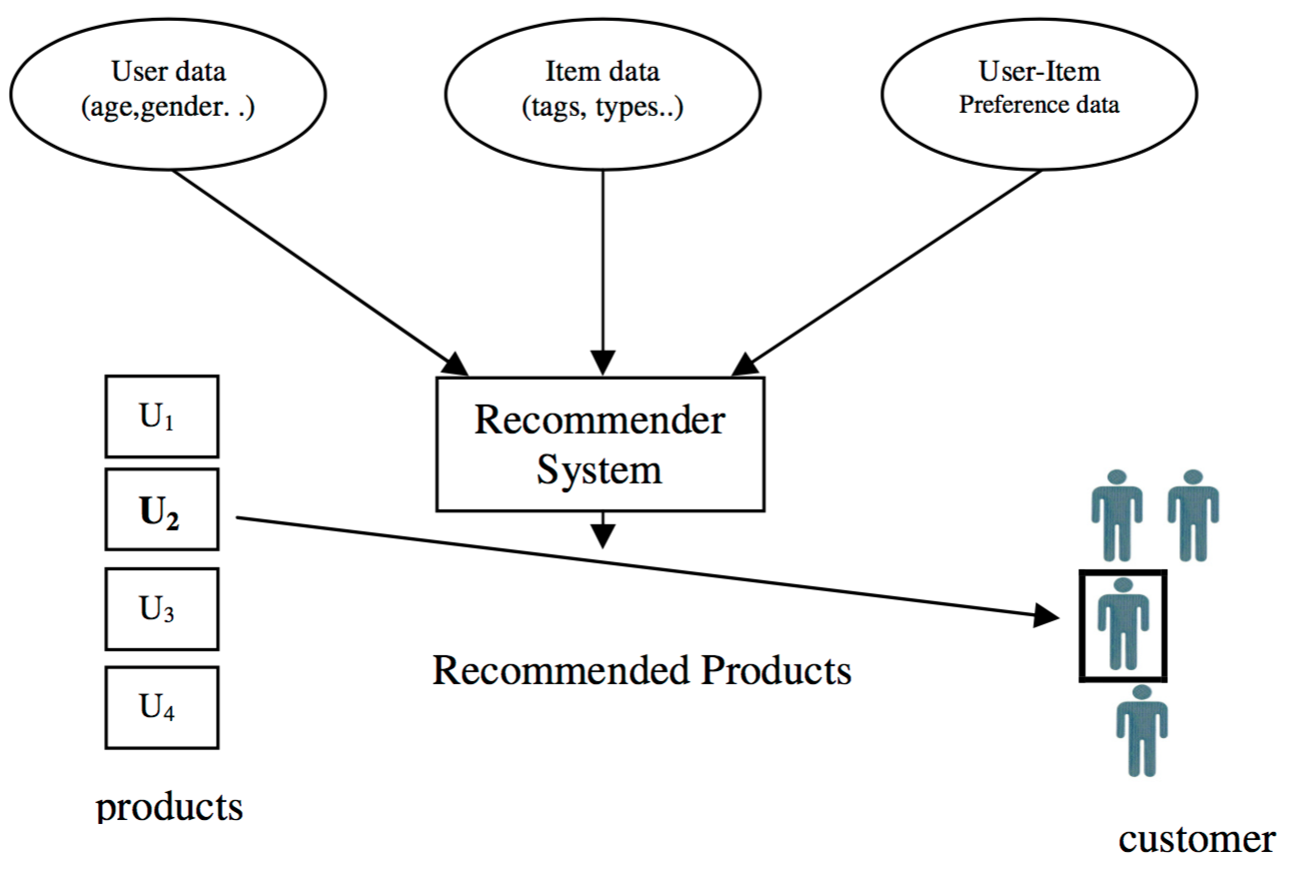





Context
(User-Item)
Explicit (given or unsupervisedly learned)
Latent (inferred from user-item interaction)
Item1
Item2
Item3
Item4

Slide 4

Recommender via Statistical Models
Using Rating Data with Gaussian Distribution for Illustration
Likelihood:
Prior Distribution:

Slide 5



A Framework for Recommenders
Recommendations jointly made based on (Hybrid Solution)
What we know about the items (Item-based)
What we know about the user (User-based)
How users interact with items (Collaborative)
Features
User Attributes
Item Attributes
Interactions (Explicit: e.g., rating, Implicit:e.g., click):
[default K=1]
Contexts of interactions (e.g., time, position):
Scores - Modeling Result:
Modeling:
Minimize
Item Features
y1 y2 … yj … yJ
x1
.
.
xi
.
.
.
xI
Interactions
E.g., Rating, Click, #View
Rij
User Features
Notes:
Currently Item refers to Article/Document when work with Media Clients.
Item reserves for the future when ecommerce is included into our customer base.
\sum_{i,j} {Dist(R_{ij}, S_{ij}(\mathbf{\theta}, C_{ij}))} + \lambda r(\mathbf{\theta})

Slide 6



Matrix-Vector Format (using Gaussian for illustration)
Fixed Effects
Random Effects

Slide 7
Alternative Formulation
Predictors (I.V.) DV
………………………...………………………...………………………… .
………………………...………………………...…………………………. .
Fixed Effects
Random Effects
I.V. = Independent Variable; DV = Dependent Variable

Slide 8
Item/User Feature Vectors
Example of Item Features Yj
________________________
Category: Business
Category: Entertainment
…
Category: Science
________________________
Words: best
Words: worst
…
Words: Surprise
________________________
Doc2Vec
Vec_1
…
Vec_100
________________________
Other: Length
…
Other: Aging
Example of User Features Xi
________________________
Interest: Business
Interest: Entertainment
…
Interest: Science
________________________
Words: best
Words: worst
…
Words: Surprise
________________________
Profile2Vec
Vec_1
…
Vec_100
________________________
Other: #views
…
Other: Demographics
0.0
0.4
…
0.1
0.0
0.2
…
0.3
0.9
...
-0.5
100
…
20
1.0
1.0
…
0.0
0.3
0.1
…
0.1
0.7
...
-0.3
80
…
30
Common Features

Slide 9
Approaches Creating Item Feature Vector: Yj
Categorization & Description
Industry Coding; Man-made Tags; Sources; Location; Image/Audio Features
Bag-of-Words:
TF, TF-IDF; Phrase & Entities; Synonym Expansion; Dimension Reduction (Feature Selection with L1/L2 Regularization; Singular Value Decomposition; Random Projection)
Topic Modeling
Latent Dirichlet Allocation (LDA); Hierarchical Dirichlet Process (LDA); lda2Vec
Semantics Modeling:
Word2Vec; lda2Vec

Slide 10
Approaches Creating User Feature Vector: Xi
Declared Profile
Demographics; Declared/implied Interest (e.g., Netflix and StitchFix)
Past Interaction with Content
Xi = F({ Yj: j ∈ ਹi }) where ਹi contains all items interacted by user i. F can be simple or weighted averaging (give higher weights to items recently interacted).
Other User-related information
Current Location; Usage-based features (web visits; devices used to access web); Search History; Item Set (similar to Bag of Words).

Slide 11

User/Item-based Methods
Unsupervised
User-Item Similarity
S(Xi, Yj): i = 1,...,I; j = 1,...,J.
Item-Item Similarities
S(Yj1, Yj2): j1, j2 = 1,…,J.
User-User Similarity
S(Xi1, Xi2): i1, i2 = 1,...,I.
Similarity:
Cosine, Pearson/Spearman Correlation Coefficient, Okapi BM25, Jaccard.
Weighted: S(Xi, Yj) = X’iWYj
Problem: how to determine W?
Supervised
Binary Ratings (logistic model)
Numerical Ratings (Gaussian Model)
Ordinal Ratings (Cumulative Logit)
Pairwise Preference Scores
Regularized M.L.E.
Notes:
S_{ij} = S(\mathbf{x}_i, \mathbf{y}_j) = \mathbf{x}_{i}^{'}A\mathbf{y}_j + \mathbf{b}'C_{ij}
R_{ij} \sim Bernoulli( (1+ exp\left \{ -S_{ij} \right \})^{-1})
R_{ij} \sim Normal( S_{ij}, \sigma^2)
R_{ij} \sim Multinomial( \pi_{ij1},...,\pi_{ijK} )
R_{ijk} \sim Bernoulli( (1 + exp\{ -(S_{ij}-S_{ik})) \} )^{-1} ))
\underset{A, \Theta}{arg \; max}(log Pr(R|A,\Theta)-\lambda r(A))

Slide 12


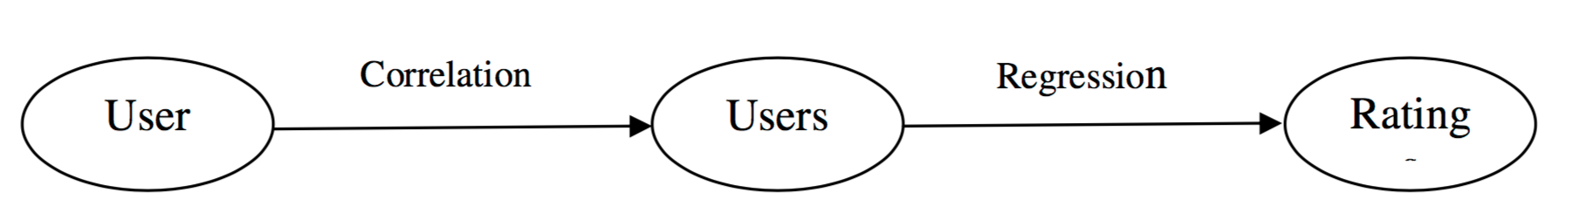

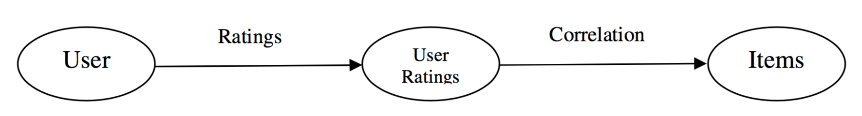
Collaborative Filtering
User-User Similarity
Similarity Function (e.g., Pearson Correlation)
Neighborhood Selection
Weighting
Matrix Factorization:
S
U
=
X
V
LxJ
I xJ
IxL
(L≪I, L≪J)
E.g., for numerical ratings
Item-Item Similarity
(Same as Above)
Optimization Methods
Alternating Least Square
Stochastic Gradient Descent
Notes:
S_{ij} = \bar{R}_{i.} + \frac{\sum_{l\in I_j(i)}{w(i,l)(R_{lj}-\bar{R}_{l.})} } { \sum_{l \in I_{j}(i)} {|w(i,l)|}}
S_{ij} = \mathbf{u}_{i}^{'}\mathbf{v}_{j}
\underset{\mathbf{u}_i,\mathbf{v}_j}{arg\;min}\sum_{i,j}(R_{ij}-S_{ij})^2

Slide 13
Putting Them Together - Hybridization (Ensemble)
Monolithic
Parallelized
Pipelined
Input
Input
Input
Recom. 1
Integrated (features, latent vectors,
methods)
Recom. n
Recom. 1
Idea_1
Idea_n
Mixed, Weighted, Switched
Recom. n
Output
Output
Output

Slide 14
More on Hybridizations
Weighted | The ratings of several recommendation techniques are combined together to produce a single recommendation
Switching | The system switches between recommendation techniques depending on the current situation
Mixed | Recommendations from several different recommenders are presented at the same time
Feature Combination | Features from different recommendation data sources are thrown together into a single recommendation algorithm
Cascade | One recommender refines the recommendations given by another
Feature Augmentation | Output from one technique is used as an input feature to another
Metal-Level | The model learned by one recommender is used as input to another

Slide 15








Integrative Approaches
Treating collaborative filtering as features: e.g., Fast Online Bilinear Factor Model (FOBFM)
Using feature-based similarity in similarity-based collaborative filtering
Collaborative filtering augmented by artificial feature-based ratings: e.g., Regression-Based Latent Factor Model (RLFM)
+
Offline
Online
leant online
Likelihood
Priors
(Or )
Notes:
S_{ijt} = \mathbf{c}_{ijt}'b + \mathbf{x}_{it}'\mathbf{A}\mathbf{y}_j+\mathbf{x}_{it}'\mathbf{v}_{jt}
\mathbf{v}_{jt} = \mathbf{B}\mathbf{\delta}_{j}
\mathbf{\delta}_{j} \sim N(\mathbf{0}, \delta^2 \mathbf{I})
S_{ijt} = \mathbf{c}_{ijt}'b + \mathbf{x}_{it}'\mathbf{A}\mathbf{y}_j+\mathbf{x}_{it}'\mathbf{B}\mathbf{\delta}_{jt}
S_{ij} = \mathbf{x}_{i}'\mathbf{A}\mathbf{y}_j + \alpha_i + \beta_j + \mathbf{u}_{i}'\mathbf{v}_j
R_{ij} \sim N(S_{ij}, \sigma^2)
R_{ij} \sim Bern( (1+exp\{ -S_{ij}\})^{-1} )
\alpha_i \sim N(g(\mathbf{x}_i), \sigma^2_{\alpha})
\beta_j \sim N(h(\mathbf{y}_j), \sigma^2_{\beta})
\mathbf{u}_i \sim N(G(\mathbf{x}_i), \sigma^2_{u}\mathbf{I})
\mathbf{v}_j \sim N(H(\mathbf{y}_j), \sigma^2_{v}\mathbf{I})

Slide 16


Other Methods and Considerations
Factorization through Latent Dirichlet Allocation
Context-Dependent Recommendation
Multi-objective Optimization
Segment approach
Personalized approach
Approximation approach
Knowledge-based Recommender
Constraint-based
Case-based (similarity between requirement and items)
Notes:
S_{ij} = \alpha_i + \beta_j + \mathbf{u}_i'\bar{\mathbf{z}}_j
\bar{z}_j = \sum_{n=1}^{W_j}{\frac{\mathbf{z}_{jn}}{W_j}}
S_{ijk} = b(\mathbf{x}_{ijk}) + \alpha_i + \beta_j + \gamma_k +<\mathbf{u}_i, \mathbf{v}_j> + <\mathbf{u}_i, \mathbf{w}_k> +<\mathbf{v}_j, \mathbf{w}_k>+ <\mathbf{u}_i, \mathbf{v}_j, \mathbf{w}_k>

Slide 17
Discussion
Our Implemented Methods (pros & cons)
Random
Jaccard Similarity
Nonnegative Matrix Factorization
Popularity-based
BPR-FM
LDA
Filtering (constraint)
TBD
Success Criteria
Relevancy (accuracy and coverage)
Novelty (diversity)
Serendipity (unexpectedness and Usefulness)
Privacy and Trust Management

Slide 18
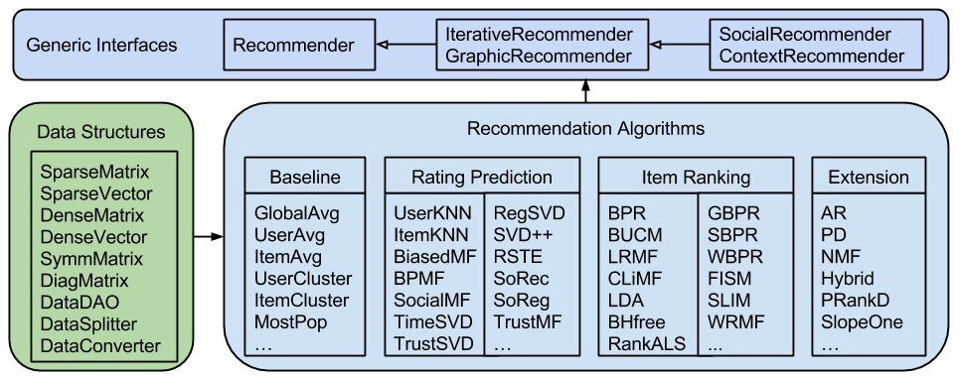
Recommender Algorithms in LibRec

Slide 19
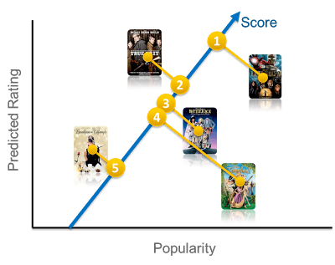
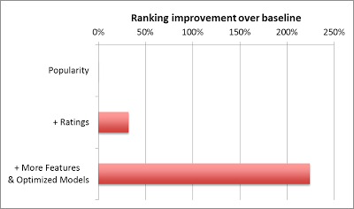
A new feature does not show value because the model cannot learn it? Or, a more powerful model is not useful simply because you don't have the feature space that exploits its benefits?
f_{rank}(u,v) = w₁ p(v) + w₂ r(u,v) + b, where u=user,
v=video item, p=popularity and r=predicted rating
Notes:
Many supervised classification methods can be used for ranking. Typical choices include Logistic Regression, Support Vector Machines, Neural Networks, or Decision Tree-based methods such as Gradient Boosted Decision Trees (GBDT). On the other hand, a great number of algorithms specifically designed for learning to rank have appeared in recent years such as RankSVM or RankBoost. There is no easy answer to choose which model will perform best in a given ranking problem. The simpler your feature space is, the simpler your model can be. But it is easy to get trapped in a situation where a new feature does not show value because the model cannot learn it. Or, the other way around, to conclude that a more powerful model is not useful simply because you don't have the feature space that exploits its benefits

